Slide 1
Nesterenko Vladimir
Information security, 4 grade
Sevastopol state university

Slide 2
Security researchers from CCSI have created a unique malware called DeepLocker. DeepLocker is new kind of malware, that uses embedded artificial neural network to define activation conditions.
Security researchers and AI

Slide 3
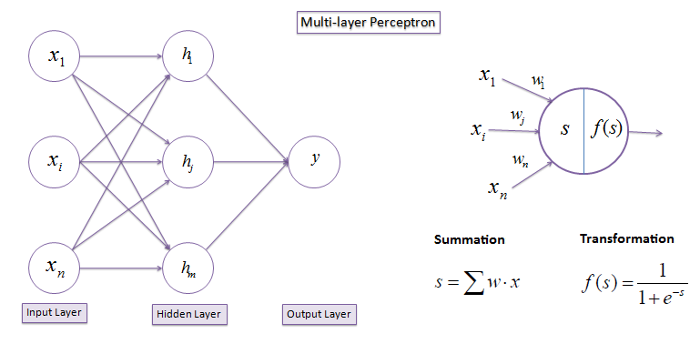
Simple multilayer perceptron

Slide 4
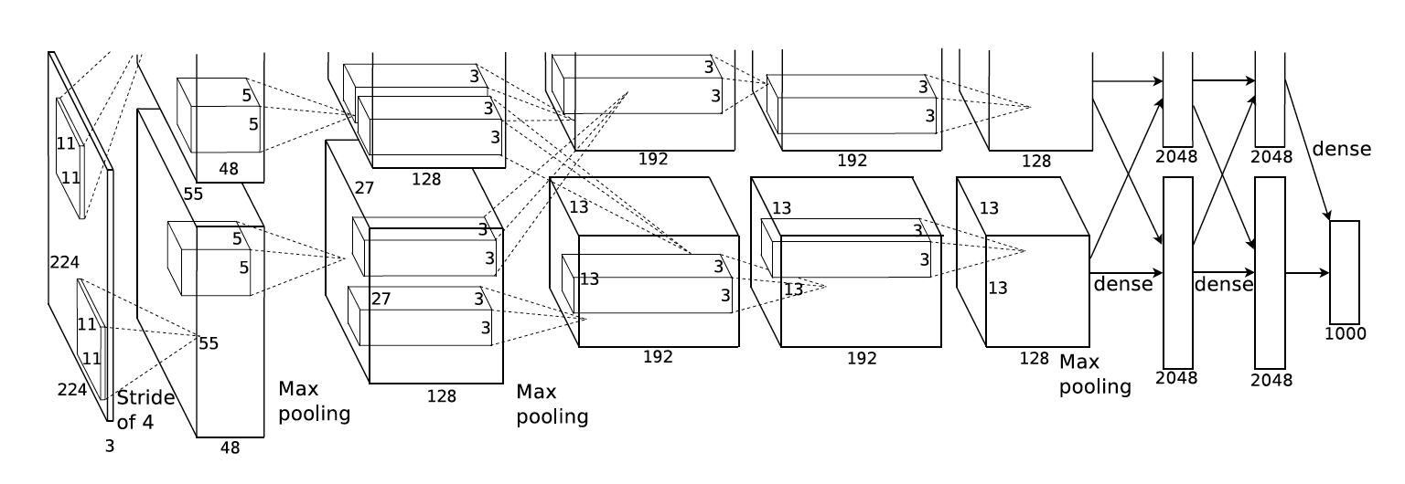
Deep Neural Networks
To find out, how DeepLocker works we need to know what is deep artificial neural networks.
A deep neural network(DNN) is an artificial neural network (ANN) with multiple layers between the input and output layers.

Slide 5
AI – aided attacks scheme
Ai supports attacking infrastructure and makes new creative attacks.

Slide 6
Ai-embedded attack
Ai embedded in malware and distributed to victim’s computer for processing some attributes. One of the newest malware of that type is DeepLocker.

Slide 7
Traditional targeted attack
START
Stuxnet
RegKeyExist(“some key”)
Is this a target?
NO
YES
Execute Attack
End

Slide 8
Ai-powered targeted attack
START
Generated by AI key for target person
NO
YES
Encrypted Payload
End

Slide 9
Ai are used to recognize target attributes and run malware payload if reference attribute was found
Target’s attributes recognition

Slide 10
Process of locking and unlocking of payload

Slide 11
DeepLocker is able to leverage the “black-box” nature of the DNN AI model to conceal the trigger condition. A simple “if this, then that” trigger condition is transformed into a deep convolutional network of the AI model that is very hard to decipher. In addition to that, it is able to convert the concealed trigger condition itself into a “password” or “key” that is required to unlock the attack payload.
DeepLocker features

Slide 12
Contents
Researchers
Perceptron
Deep Neural Network
AI-aided attacks
AI-embedded attacks. DeepLocker
Traditional targeted attacks
AI-aided targeted attacks
Target’s attributes recognition
Process of locking and unlocking Payload
DeepLocker features

Slide 13
Thank you for attention

