Slide 1
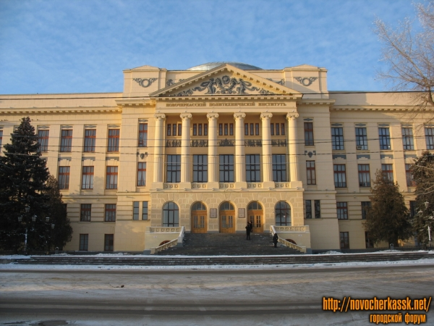
Federal state budgetary educational institution of higher professional education
“M.I. Platov South-Russia State
Polytechnic University (NPI)”

Slide 2
CRYPTOGRAPHY ALGORITHMS RESISTANT TO QUANTUM COMPUTERS. POST-QUANTUM CRYPTOGRAPHY.
2
Author: student Stekhov Stanislav Nikolaevich

Slide 3
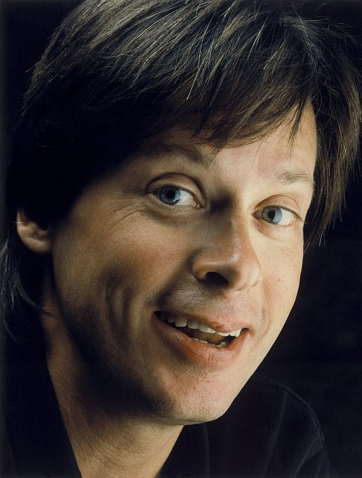
3
In the Computer Revolution everything changes way too fast for the human brain to comprehend. That is why only 14-year-olds really understand what is going on.
© Dave Barry

Slide 4
CPU performance improvement graph
4

Slide 5
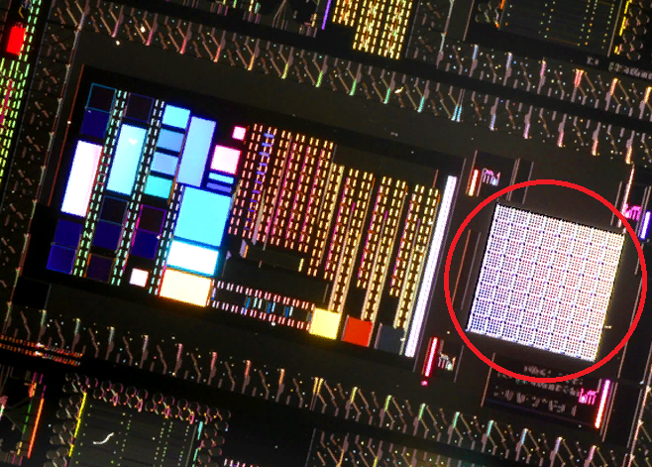
Quantum computer The CPU in the red circle
5

Slide 6
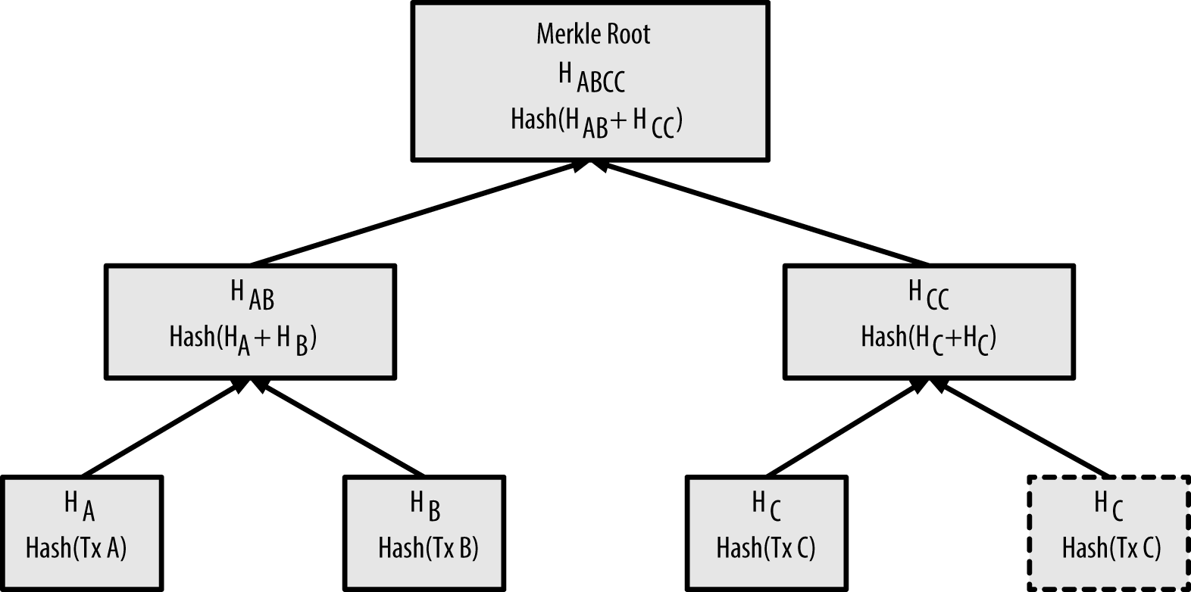
Six approaches to solve the problem of quantum attacks:
1) Cryptography based on hash functions. (Merkle signature with Merkle hash-tree)

Slide 7
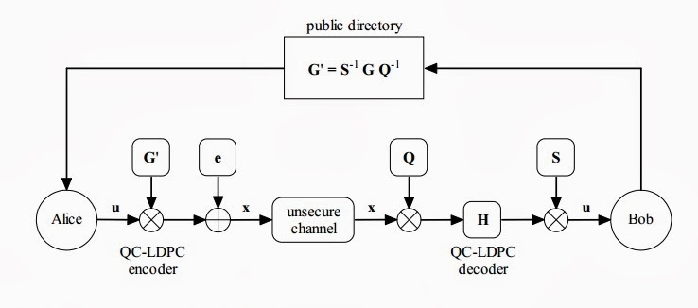
Six approaches to solve the problem of quantum attacks:
2) Cryptography based on error correction codes, for example McEliece
The McEliece cryptosystem based on QC-LDPC codes

Slide 8
Six approaches to solve the problem of quantum attacks:
3) Lattice-based cryptography, for example Ring-Learning with Errors.
4) Cryptography based on multivariate quadratic schemes, for example Hidden Field Equations

Slide 9
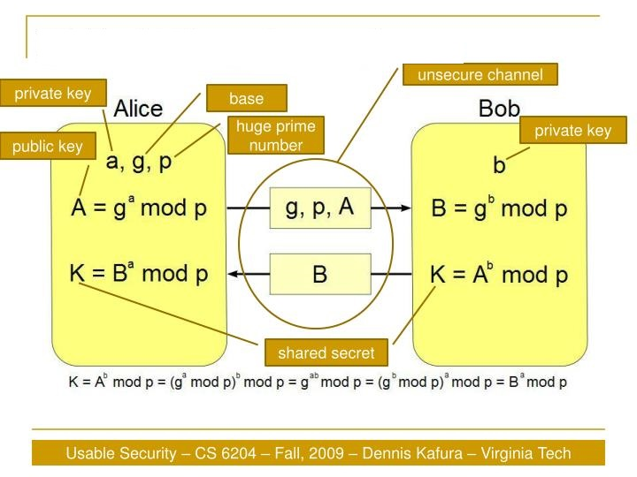
Six approaches to solve the problem of quantum attacks:
5) Encryption using supersingular isogeny, analogous to famous Diffie-Hellman Protocol.
Diffie-Hellman
key exchange

Slide 10
Six approaches to solve the problem of quantum attacks:
6) Encryption with secret key. Advanced Encryption Standard(AES)

Slide 11
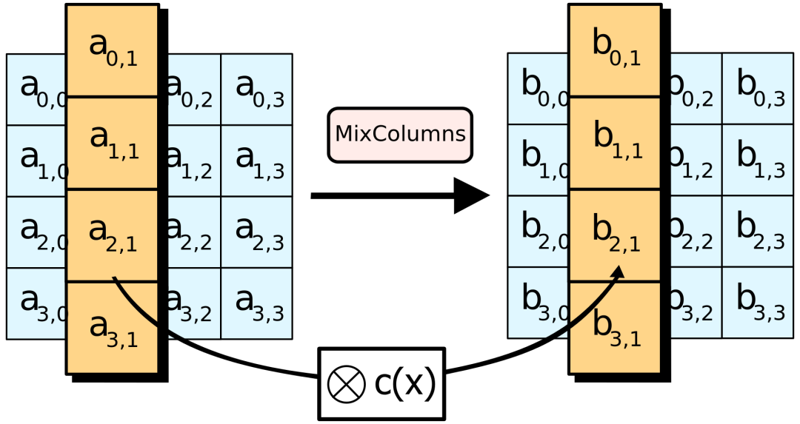
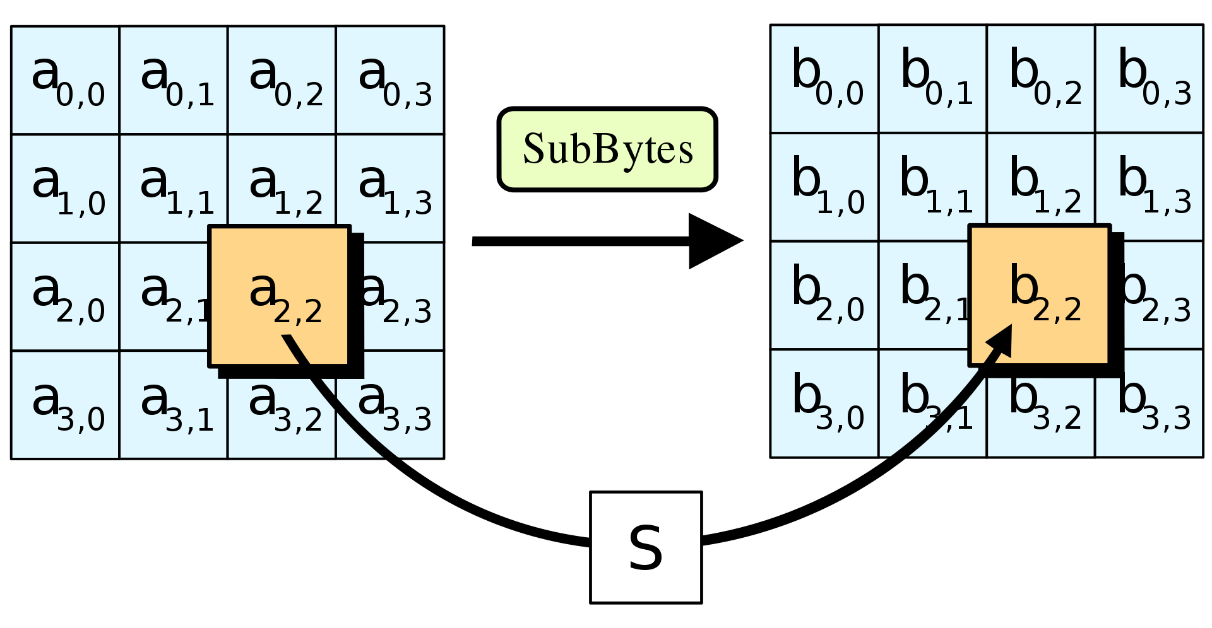
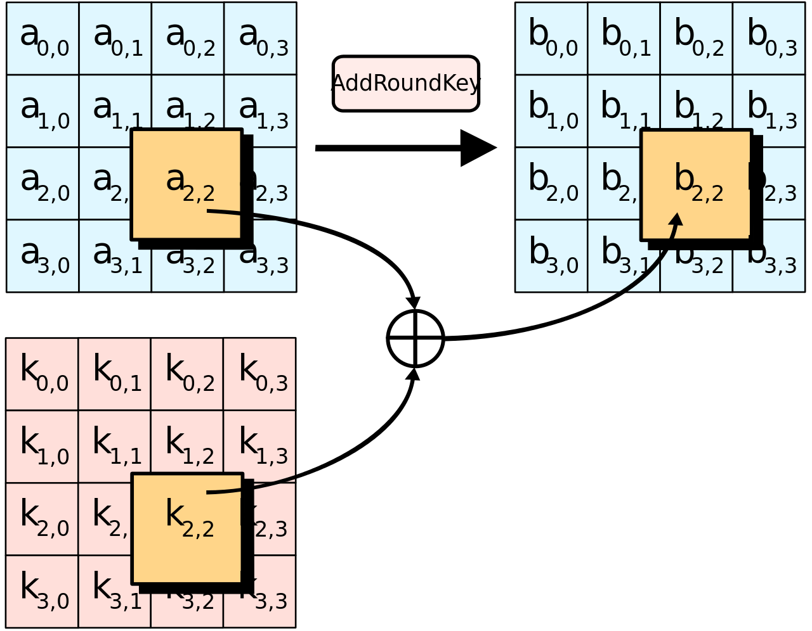
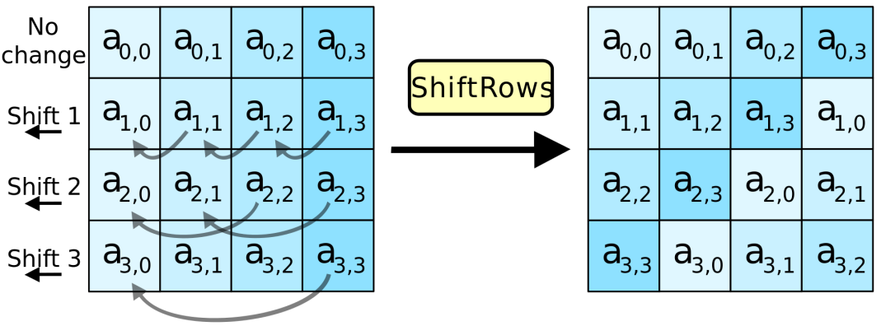
AES operations
6
SubBytes
MixColumns
ShiftRows
AddRoundKey

Slide 12
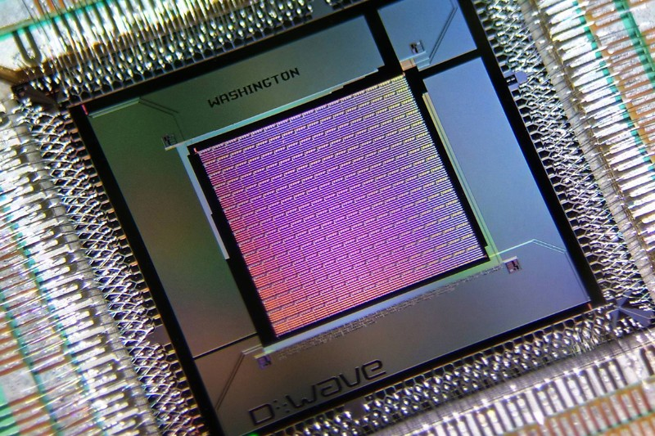
Quantum processor

Slide 13
Thank you for your attention
11

