Slide 1
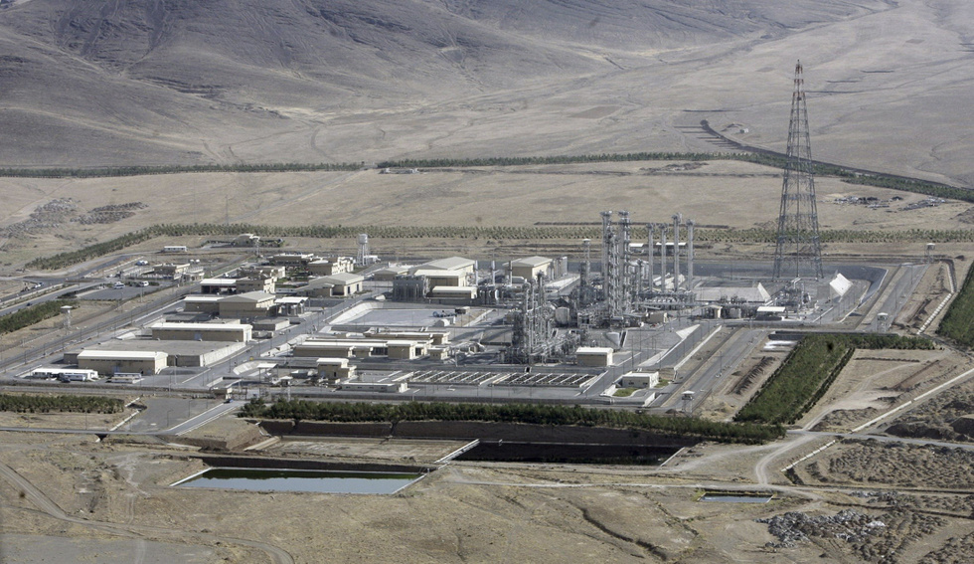
INFORMATION AND COMMUNICATION TECHLOLOGIES.
INFORMATION WARS AND IT RACE
DIANA VOILOVA
Kuban State Technological University
OLGA GAMAEVA
Gymnasium № 23

Slide 2
what is information and communication technology?
Information and Communication technology is understood as «a process that uses a set of means and methods to collect, process and transmit data, to obtain information of a new quality about the state of an object, process or phenomenon. The main aim of communication technology is the production of information for analysis and decision-making "

Slide 3
Why to study information and communication technologies?
Modern information and communication technologies are widely used for aggressive purposes. Combined with extremist, nationalist and racist actions, they are capable of disrupting a stable environment and collapsing the government in any country, both in the most civilized and in still developing states. The world community has already realized their power on the example of many states (Libya, Afghanistan, Iraq, etc.), which suggests that the problem of information warfare in the whole world is not just very urgent, but vital. Journalists have invented the term "information war", that means «psychological pressure on the whole society or part of it. Skillful presentation of the necessary information that helps to create certain public opinions and cause predictable reactions"

Slide 4
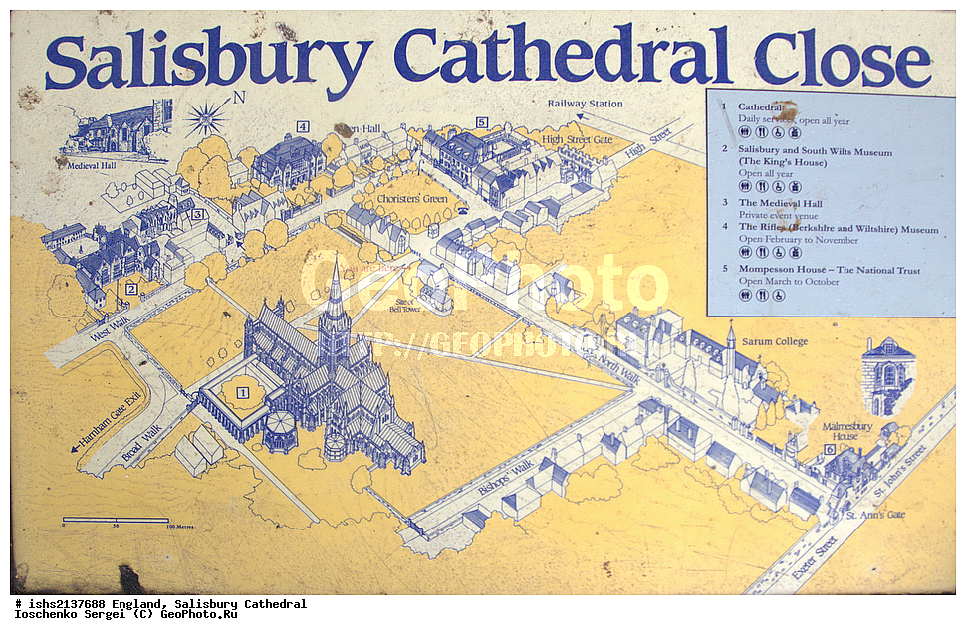
It’s important to know what means are used to conduct such "wars“
Information impacts are conducted through quite peaceful means - mass media, Internet, telecommunications, communications, through publications of false information in mass media, interviews and publication of extremist statements, carrying out racist flash mobs.

Slide 5
high - tech computer technologies as the most dangerous weapons of any information war
It is important to understand that besides the means of propaganda, the most dangerous weapons of any information war are rapidly improving and spreading high - tech computer technologies - computer attacks on crucial life-supporting objects. To stop the operation of such industrial and infrastructural objects means to "warm up" the situation in any country to "social explosion".

Slide 6
the results of It race
The development of information technologies will certainly lead to the growth of the range of information weapons, as well as to the increase of the list of objects that can be easily attacked. The situation is getting even more complicated by the fact that these weapons can fall into the hands of terrorists and criminal structures. In this case, the consequences of their application will be unpredictable.

Slide 7
IT as means of destruction
Types:
Groups:
extracting the necessary information from databases after overcoming the protection systems;
restricting or prohibiting the access to legitimate users;
disrupting of technical means; disabling telecommunication networks, computer systems, all high-tech support of society and damaging the functioning of the state
means of control suppression systems;
means of electronic warfare;
means of software and technical damage of enemy information systems;
means of psychological manipulation of a population in order to destabilize society and the state;
virus attacks on financial state institutions to destabilize the state economy

Slide 8
... our opponents are determined to control their elements of cyberspace, steal our intellectual property and disrupt the work of our agencies" and "...we have little hope that they will behave responsibly in cyberspace
Statement of Admiral Michael S Rogers Commander United States Cyber Command before the Senate Committee on Armed Services, 19 March 2015
Some states propose that members of the international community commit themselves not to use IT for purposes contrary to the maintenance of international peace and security, to build confidence and to eliminate the threat of force. Unfortunately, some countries believe otherwise. According to them, to maintain peace and information security it is necessary to follow the strategy of power.

Slide 9
The concept of power is impossible to follow, because:
There is no threat of mutual destruction as a guarantee factor
A large number of countries has already got all the necessary technologies to develop IT weapons (there is no control)
Models of information weapons are much easier to develop, produce and transfer to anyone than nuclear weapons technology. Therefore, it is extremely difficult to achieve convincing superiority over rivals.
The source of the information attack in computer networks is difficult to trace.

Slide 10
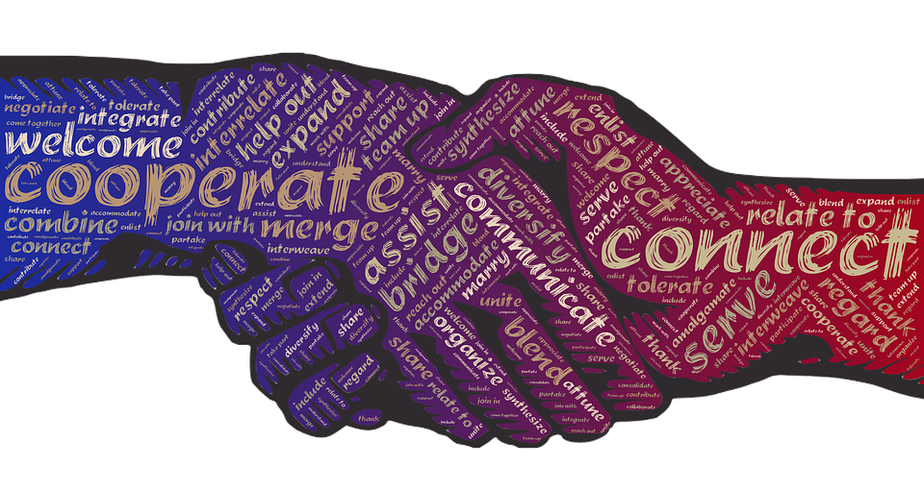
Conclusion to guarantee responsibility in cyberspace one must:
1. every specialist working in the field of information technology will exercise broad international cooperation in addressing the global problem of countering the threat of information wars, the spread of information weapons;
2. the main goal of cooperation is to establish an international legal regime for ensuring global information security, which regulates the aggressive activities of states in the information space on the basis of the principles and norms of international law;
3. Experts who prevent the emergence of information conflicts advocate the creation of mechanisms for bilateral and multilateral cooperation on military aspects of international information security.

Slide 11
References:
The concept of information technology. Types of information technologies [Electronic resource]. – Mode of access: https://www.yaklass.ru/materiali?mode=cht&chtid=456 (date accessed: 01.02.19).
Information war in the modern world [Electronic resource]. – Mode of access: http://kak-bog.ru/informacionnaya-voyna-v-sovremennom-mire (date accessed: 01.02.19).
E. B. Belov, V. P. Moose and R. Mescheriakov, A. A. Shelupanov. Fundamentals of information security. // Moscow, 2006. P. 64 – 68.
John. Nai. Geopolitics of deterring cyber attacks between States on the Internet [Electronic resource]. – Mode of access: http://kiber.akipress.org/news:192. (date accessed: 02.02.19).
K. Girs Containment of information confrontation [Electronic resource]. – Mode of access: http://www.iisi.msu.ru/forum/stenogramma/ (accessed: 02.02.19).
Statement of Admiral Michael S Rogers Commander United States Cyber Command before the Senate Committee on Armed Services, 19 March 2015 [Electronic resource]. – Mode of access: http://www.armed-services.senate.gov/imo/media/doc/Rogers_03-19-15.pdf (date accessed: 02.02.19).
S. N. Rodionov, S. V. Korotkov, S. V. Ustyugov. On the directions of promotion of the Russian initiative on international information security / / Project MIL.PRESS [Electronic resource]. – Mode of access: https://flot.com/publications/books/shelf/safety/21.htm

