Slide 1
Neuro-linguistic programming in the advertising
Completed: 2nd year student of Volgograd State University
Ipatova Angelina Sergeevna
Specialty: information security of automated systems

Slide 2
Relevance of the topic
Nowadays, a person faces a tremendous amount of information.
Today, advertising is an essential attribute of life.

Slide 3
About the subject
NLP technologies are used to determine the thinking strategies of the target audience, which makes it possible to code advertising messages that form the necessary idea of ​​a product or service with the consumer.

Slide 4
The most commonly used methods: adjustment by values and submodalities
Adjustment by values ​​involves the involvement in the advertising message of images that are valuable and sacred to the target audience.
This principle of submodalities is based on drawing attention on the basis of visual, audial and kinesthetic perception of the situation.

Slide 5
The most commonly used methods: presuppositions and synesthesia
The presuppositions are built on the revolutions of speech, which, in conjunction with the axioms, create situations in which the choice of only the advertised product is actually provided.
Synesthesia involves a mix of information channels.

Slide 6
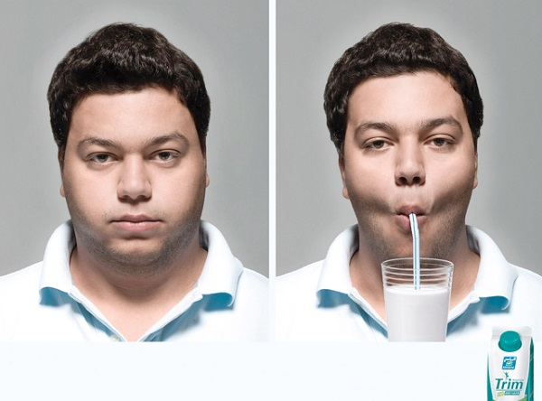
The most commonly used methods: truism and the illusion of choice
A truism is a well-known truth, which is used only as a reminder.
The illusion of choice presupposes the establishment of a framework for a person, giving him the seemingly opportunity to make a choice, which is actually limited

Slide 7
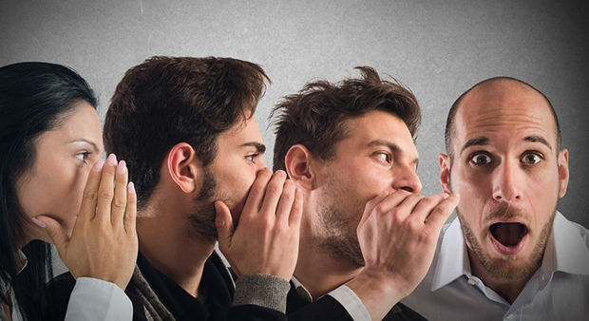
The most commonly used methods: metaprogramms and thought Virus
Meta-programs are man-made psychological attitudes that he applies to all the information he receives.
The idea of ​​a virus is the unauthorized distribution of information to a mass of people, made by themselves.

Slide 8
Thanks for your attention!

